Slide 1
This Week
Validated some results
Since the solver is working now, wrote up some large chunks of my thesis

Slide 2
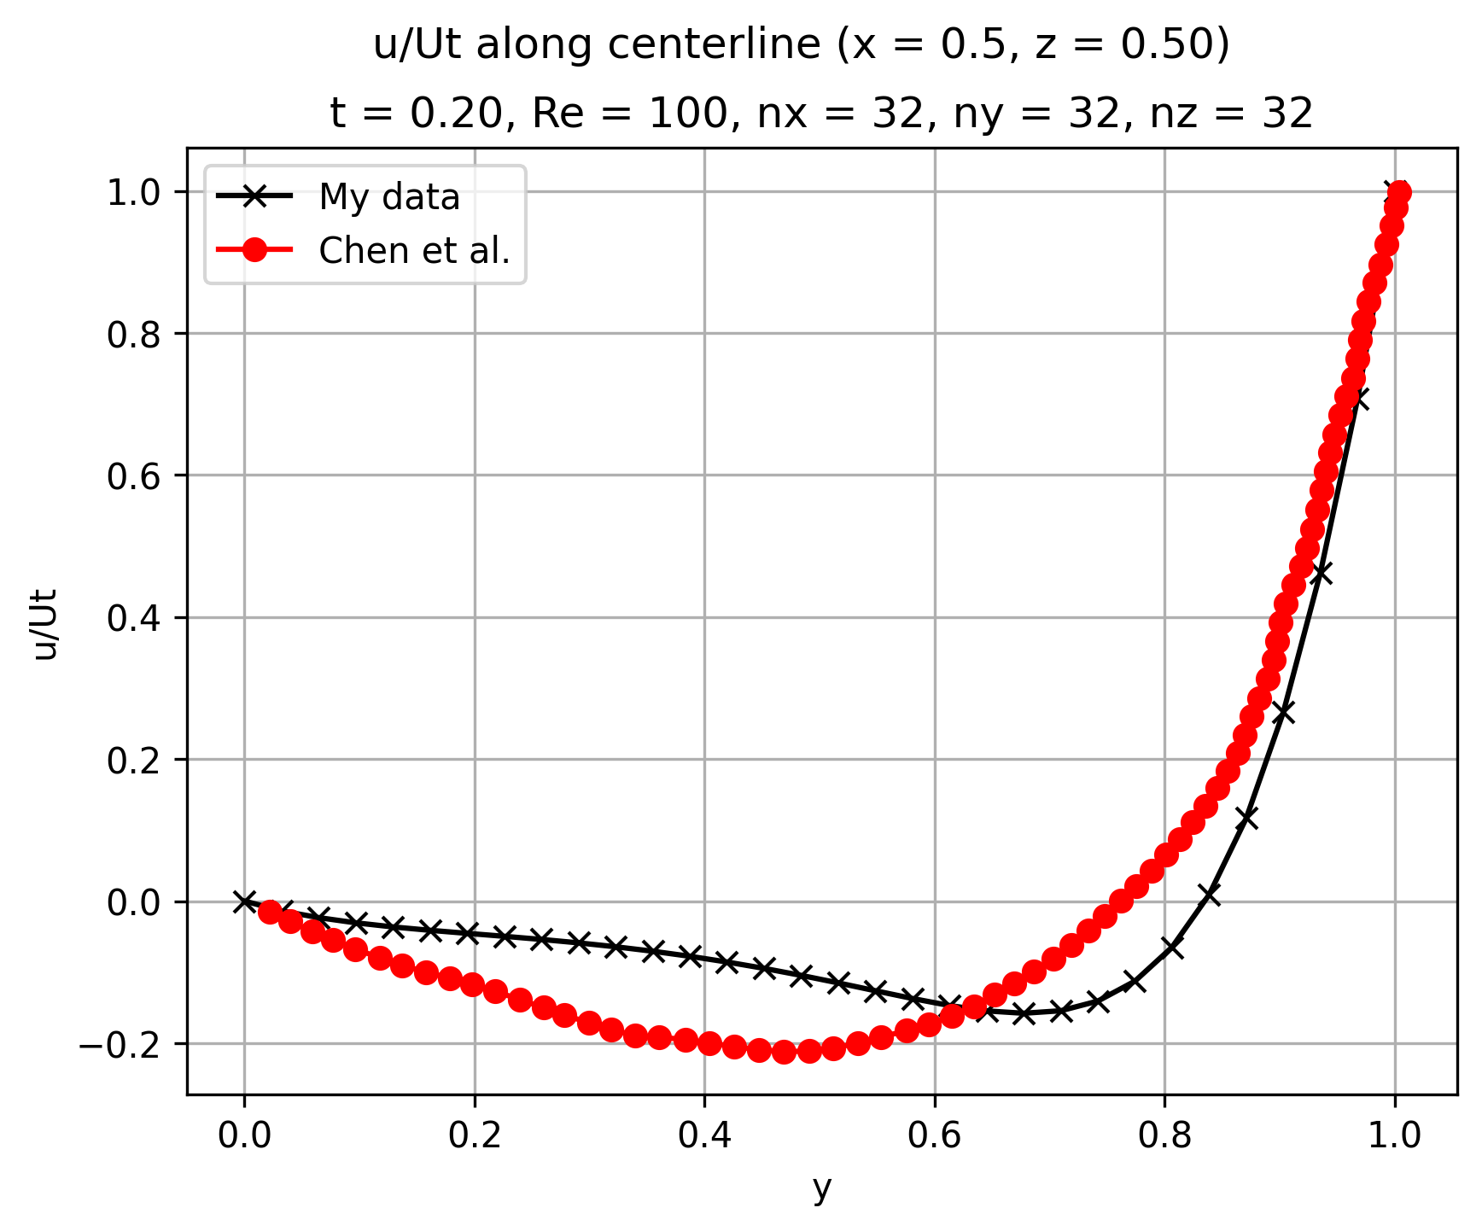
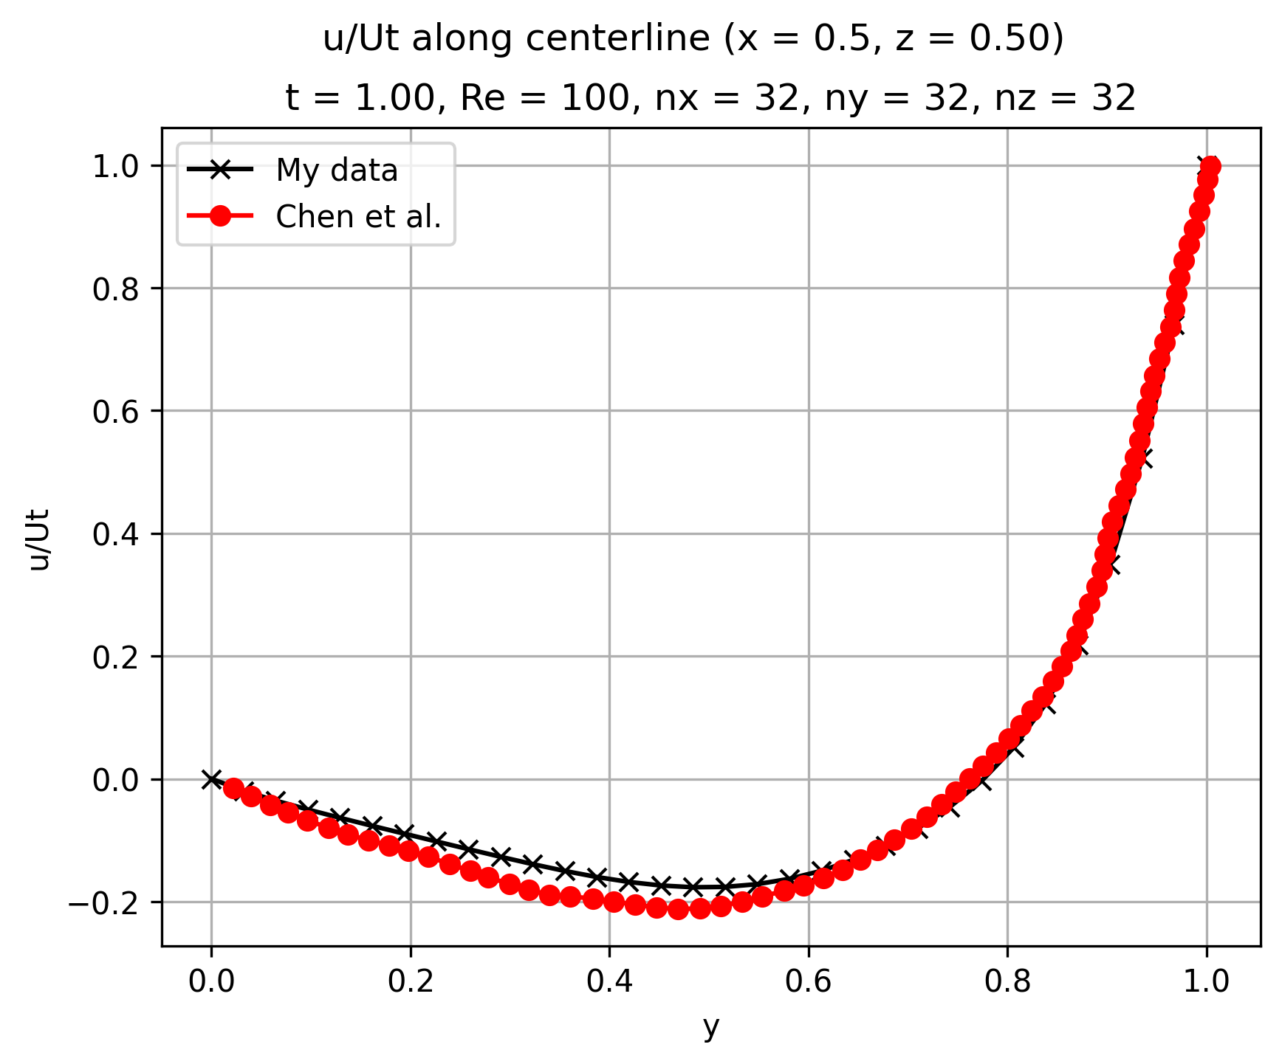
Lid
Motion

Slide 3
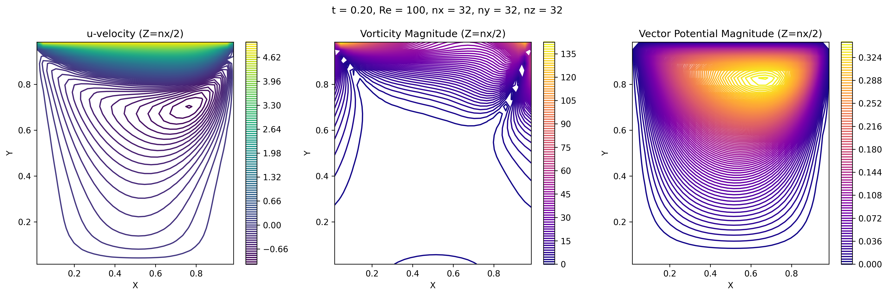
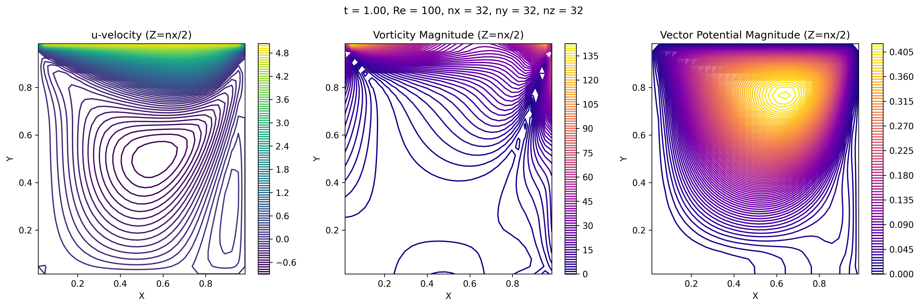
On the vertical centre plane...
Lid
Motion
T = 0.2 s
Re = 100
T = 1.00 s
Re = 100

Slide 4
Next steps
Add convergence criteria
Use multiple processors
Vectorise
Check divergence of velocity
Check divergence of vorticity
Try out a different set of schemes, check by substituting into divergence equations and solving algebraically
Try higher Re

